Slide 1
Digital Design &
Computer Architecture
Sarah Harris & David Harris
with Joshua Brake
Chapter 9:
Embedded Systems

Slide 2
Chapter 9 :: Topics
Microcontrollers
RISC-V Microcontrollers
Memory-Mapped I/O
General-Purpose I/O
Device Drivers
Delays & Timers
Example: Morse Code
Interfacing
Serial Peripheral Interface
Example: SPI Accelerometer

Slide 3
Microcontrollers
Microprocessors are computers on a chip
Microcontrollers are microprocessors with flexible input/output (I/O) peripherals
Peripheral examples:
General-purpose I/O (GPIO): turn pins ON and OFF
Serial ports
Timers
Analog/Digital and Digital/Analog Converters (ADC/DAC)
Pulse Width Modulation (PWM)
Universal Serial Bus
Ethernet

Slide 4
Embedded Systems
Microcontrollers are commonly used in embedded systems
An embedded system is a system whose user may be unaware there is a computer inside
Examples:
Microwave oven
Clock/radio
Electronic fuel injection
Annoying toys with batteries for toddlers
Implantable glucose monitor

Slide 5
Microcontroller Economics
In 2019, about 26 billion microcontrollers sold
Average price: 60 cents
About 70 microcontrollers in an average new car
Biggest markets:
Automotive (~70 microcontrollers in an average new car)
Consumer electronics, industrial, medical, military
Highly cost-sensitive market
Often < $0.40; pennies matter
Cheaper than using a cable or a pushrod in a system
A microcontroller integrated on a larger chip can have a manufacturing cost of < $0.001
Memory tends to dominate the cost
Select one with no more memory than necessary
Classified as 8, 16, 32-bit based on internal bus
1970s vintage 8-bit processors can still be adequate
16-bit have greatest revenue in 2019
32-bit processors are faster and more flexible but use more code memory

Slide 6
Microprocessor Architectures
The architecture is the native machine language a microprocessor understands.
Commercial Examples:
RISC-V
ARM
PIC
8051

Slide 7
Embedded Systems
RISC-V
Microcontrollers

Slide 8
RISC-V Microcontrollers
RISC-V is an open-standard architecture
Developed at Berkeley starting in 2010
No licensing fees
Increasingly popular, especially for system-on-chip
SiFive Freedom E310-G002
Second generation RISC-V microcontroller (2019)
Found on several low-cost boards

Slide 9
SiFive Freedom E310 Microprocessor
E31 microprocessor with 5-stage pipeline
Similar to the one we will discuss in class
RV32IMAC architecture
Baseline 32-bit RISC-V Integer instructions
Plus Multiply/Divide, Atomic Memory, Compressed operations
2.73 Coremark/MHz
Electrical Specs
Up to 320 MHz
Built in antiquated 180 nm process
1.8V core and 3.3V I/O

Slide 10
FE310 Memory & I/O
Onboard Memory
16 KB Data SRAM
16 KB Instruction Cache
8 KB Mask ROM & 8 KB OTP (one-time-programmable) Program Boot Memory
Most instructions located on external Flash
I/O Peripherals
19 GPIO Pins
Serial Ports: SPI x2, I2C, UART x2
PWM x3
Timer
JTAG Debugger Interface

Slide 11
FE310 Pinout
48-pin QFN (quad flat pack, no leads)
Hard to hand solder
Pins:
12 power (GND pad on back)
19 GPIO
4 JTAG programming
6 QSPI Flash code link
2 clock crystals
6 control
designnews.com
FE310 Manual

Slide 12
FE310 Boards
SparkFun RED-V Thing Plus
SparkFun RED-V RedBoard
HiFive 1
sifive.com
$30
Fits breadboard (2.3x0.9”)
Requires soldering
header pins
sparkfun.com
$40
Headers soldered
Nonstandard pin labels
$60
WiFi & Bluetooth

Slide 13
Comparison of FE310 Boards
Boards are functionally similar
Can operate off USB connection
Power, programming, debugging
External power connector
All I/Os tapped out to pins
Software compatible
This course uses RED-V Thing Plus for labs
Lowest cost
Breadboard-compatible

Slide 14
FE310 Datasheets
FE310-G002 Datasheet
Pinout
Electrical specifications
Information for board designer
FE310-G002 Manual
Microprocessor core
Memory map
Peripherals
Information for firmware engineer / programmer

Slide 15
Embedded Systems
Memory-Mapped I/O

Slide 16
Memory-Mapped I/O
Control peripherals by reading or writing memory locations called registers
Not really the same as a bank of flip-flops
Just like accessing any other variable, but these registers cause physical things to happen.
Portion of the address space is reserved for I/O registers rather than program or data.
In C, use pointers to specify addresses to read or write.

Slide 17
Example: FE310 Memory Map
Boot ROM:
0x00010000-1FFFF
Code Flash:
0x20000000-3FFFFFFF
Data SRAM:
0x80000000-80003FFF
Peripherals:
0x02000000-0x1FFFFFFF
From FE310 Manual

Slide 18
Memory Mapped I/O in C
#include <stdint.h>
// Pointers to memory-mapped I/O registers
volatile uint32_t *GPIO_INPUT_VAL = (uint32_t*)0x10012000;
volatile uint32_t *GPIO_OUTPUT_VAL = (uint32_t*)0x1001200C;
// read all the GPIO inputs
uint32_t allInputs = *GPIO_INPUT_VAL;
// read GPIO bit 19
int gpio19 = (*GPIO_INPUT_VAL >> 19) & 0b1;
// Wait for bit 19 to be 0
while ((*GPIO_INPUT_VAL >> 19) & 0b1);
// Wait for bit 19 to be 1
while (!((*GPIO_INPUT_VAL >> 19) & 0b1));
// Write 1 to GPIO bit 5
*GPIO_OUTPUT_VAL |= (1<<5);
// Write 0 to GPIO bit 5
*GPIO_OUTPUT_VAL &= ~(1<<5);

Slide 19
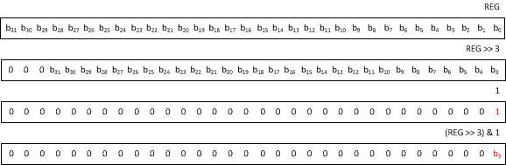
C Idioms: Read value of bit
int bit = (*REG >> 3) & 1; // get value of bit 3

Slide 20
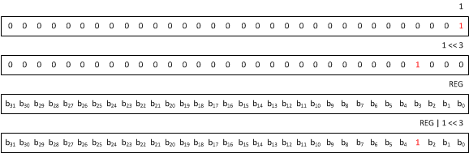
C Idioms: Write Bit to 1
*REG |= (1 << 3); // turn on bit 3

Slide 21
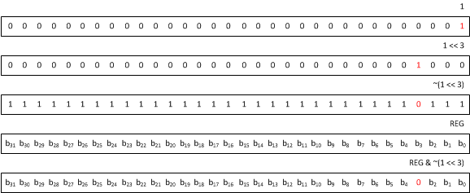
C Idioms: Write Bit to 0
*REG &= ~(1 << 3); // turn off bit 3

Slide 22
Embedded Systems
General Purpose I/O
(GPIO)

Slide 23
General-Purpose I/O (GPIO)
GPIOs can be written (driven to 0 or 1) or read.
Examples: LEDs, switches, connections to other digital logic
In general:
Look up how many pins your microcontroller has, how they are named.
Each pin needs to be configured as an input, output, or special function.
Then read or write the pin.

Slide 24
FE310 GPIOs
19 GPIOs connected to external pins
Not enough pins for all 32 GPIOs
Some GPIOs have multiple functions
Blue LED on RED-V board
Connected to GPIO5

Slide 25
FE310 GPIO Registers
From FE310 Manual
Base Address
0x10012000
32 bits/reg
For 32 GPIOs
* means enable resets to 0
Turn on enable to use GPIO
0x38 iof_en Enable I/O function
0x3C iof_sel Select I/O function

Slide 26
FE310 GPIO With Enables
#include <stdint.h>
volatile uint32_t *GPIO_INPUT_VAL = (uint32_t*)0x10012000;
volatile uint32_t *GPIO_INPUT_EN = (uint32_t*)0x10012004;
volatile uint32_t *GPIO_OUTPUT_EN = (uint32_t*)0x10012008;
volatile uint32_t *GPIO_OUTPUT_VAL = (uint32_t*)0x1001200C;
// Enable input 19 and output 5
*GPIO_INPUT_EN |= (1 << 19);
*GPIO_OUTPUT_EN |= (1 << 5);
// read GPIO bit 19
int gpio19 = (*GPIO_INPUT_VAL >> 19) & 0b1;
// Wait for bit 19 to be 1
while (!((*GPIO_INPUT_VAL >> 19) & 0b1));
// Write 1 to GPIO bit 5
*GPIO_OUTPUT_VAL |= (1<<5);
// Write 0 to GPIO bit 5
*GPIO_OUTPUT_VAL &= ~(1<<5);

Slide 27
RED-V RedBoard Pin Names
Red-V Pin Name | GPIO Number
D0 | 16
D1 | 17
D2 | 18
D3 | 19
D4 | 20
D5 | 21
D6 | 22
D7 | 23
D8 | 0
D9 | 1
D10 | 2
D11 | 3
D12 | 4
D13 | 5
D15 | 9
D16 | 10
D17 | 11
D18 | 12
D19 | 13
RED-V RedBoard has Arduino-style pin names
Translate these to GPIO numbers

Slide 28
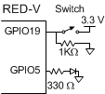
Example: Switches & LEDs
Read a switch and drive an LED
(Could have done this with a wire!)
#include <stdint.h>
void main(void) {
volatile uint32_t *GPIO_INPUT_VAL = (uint32_t*)0x10012000;
volatile uint32_t *GPIO_INPUT_EN = (uint32_t*)0x10012004;
volatile uint32_t *GPIO_OUTPUT_EN = (uint32_t*)0x10012008;
volatile uint32_t *GPIO_OUTPUT_VAL = (uint32_t*)0x1001200C;
int val;
*GPIO_INPUT_EN |= (1 << 19); // Set pin 19 to input
*GPIO_OUTPUT_EN |= (1 << 5); // set pin 5 to output
while (1) {
val = (*GPIO_INPUT_VAL >> 19) & 1; // Read value on pin 19
if (val) *GPIO_OUTPUT_VAL |= (1 << 5); // Turn ON pin 5
else *GPIO_OUTPUT_VAL &= ~(1 << 5); // Turn OFF pin 5
}
}

Slide 29
Other I/O Functions
Most GPIO pins also have other special functions
Serial Ports: SPI, I2C, UART
Pulse Width Modulation
Activate with GPIO registers
iof_en enables special function
iof_sel selects the function
From FE310 Manual

Slide 30
Embedded Systems
EasyREDVIO
Device Driver
Library

Slide 31
Device Drivers
Controlling memory mapped I/O with pointers is error-prone
Hard to see the big picture
Easy to mistype address of GPIO
Pointer programming can confuse beginners
Write device driver functions to hide the details
We will develop EasyREDVIO device driver library
Arduino-style interface
Start with GPIO

Slide 32
Memory-Mapped I/O with Structures
Use structures to define memory-mapped I/O
Less error-prone than pointers
Cleaner C code

Slide 33
EasyREDVIO Library
// EasyREDVIO.h
// Joshua Brake and David Harris 7 October 2020
#define INPUT 0
#define OUTPUT 1
// Declare a GPIO structure defining the GPIO registers in the order they appear in memory mapped I/O
typedef struct
{
volatile uint32_t input_val; // (GPIO offset 0x00) Pin value
volatile uint32_t input_en; // (GPIO offset 0x04) Pin input enable*
volatile uint32_t output_en; // (GPIO offset 0x08) Pin output enable*
volatile uint32_t output_val; // (GPIO offset 0x0C) Output value
volatile uint32_t pue; // (GPIO offset 0x10) Internal pull-up enable*
volatile uint32_t ds; // (GPIO offset 0x14) Pin drive strength
volatile uint32_t rise_ie; // (GPIO offset 0x18) Rise interrupt enable
volatile uint32_t rise_ip; // (GPIO offset 0x1C) Rise interrupt pending
volatile uint32_t fall_ie; // (GPIO offset 0x20) Fall interrupt enable
volatile uint32_t fall_ip; // (GPIO offset 0x24) Fall interrupt pending
volatile uint32_t high_ie; // (GPIO offset 0x28) High interrupt enable
volatile uint32_t high_ip; // (GPIO offset 0x2C) High interrupt pending
volatile uint32_t low_ie; // (GPIO offset 0x30) Low interrupt enable
volatile uint32_t low_ip; // (GPIO offset 0x34) Low interrupt pending
volatile uint32_t iof_en; // (GPIO offset 0x38) HW-Driven functions enable
volatile uint32_t iof_sel; // (GPIO offset 0x3C) HW-Driven functions selection
volatile uint32_t out_xor; // (GPIO offset 0x40) Output XOR (invert)
} GPIO;
// Define the base address of the GPIO registers and a pointer to this structure
// The 0x…U notation in 0x10012000U indicates an unsigned hexadecimal number
#define GPIO0_BASE (0x10012000U)
#define GPIO0 ((GPIO*) GPIO0_BASE)

Slide 34
EasyREDVIO Library
void pinMode(int gpio_pin, int function) {
switch(function) {
case INPUT:
GPIO0->input_en |= (1 << gpio_pin); // Sets a pin as an input
GPIO0->output_en &= ~(1 << gpio_pin); // Disable output
GPIO0->iof_en &= ~(1 << gpio_pin); // Disable IOF
break;
case OUTPUT:
GPIO0->output_en |= (1 << gpio_pin); // Set pin as an output
GPIO0->input_en &= ~(1 << gpio_pin); // Disable input
GPIO0->iof_en &= ~(1 << gpio_pin); // Disable IOF
break;
}
}
void digitalWrite(int gpio_pin, int val) {
if (val) GPIO0->output_val |= (1 << gpio_pin);
else GPIO0->output_val &= ~(1 << gpio_pin);
}
int digitalRead(int gpio_pin) {
return (GPIO0->input_val >> gpio_pin) & 0x1;
}

Slide 35
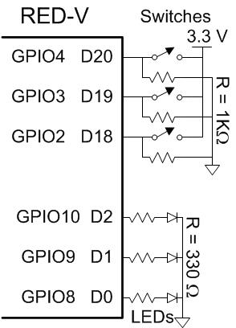
Example: Switches & LEDs
Reprised with EasyREDVIO
Control all three LEDs
#include "EasyREDVIO.h"
int main(void) {
// Set GPIO 4:2 as inputs
pinMode(2, INPUT);
pinMode(3, INPUT);
pinMode(4, INPUT);
// Set GPIO 10:8 as outputs
pinMode(8, OUTPUT);
pinMode(9, OUTPUT);
pinMode(10, OUTPUT);
while (1) { // Read each switch and write corresponding LED
digitalWrite(8, digitalRead(2));
digitalWrite(9, digitalRead(3));
digitalWrite(10, digitalRead(4));
}
}

Slide 36
Embedded Systems
Delays & Timers

Slide 37
Generating Delays
#define COUNTS_PER_MS 1600
void delayLoop(int ms) {
// declare loop counter volatile so it isn't optimized away
// COUNTS_PER_MS empirically determined such that
// delayLoop(1000) waits 1 sec
volatile int i = COUNTS_PER_MS * ms;
while (i--); // count down time
}

Slide 38
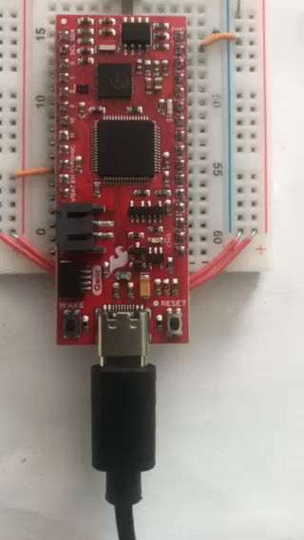
Blink Light
void flash(void) {
pinMode(5, OUTPUT);
while (1) {
digitalWrite(5, 1);
delayLoop(500);
digitalWrite(5, 0);
delayLoop(500);
}
}

Slide 39
Timers
delayLoop requires calibrating COUNTS_PER_MS
Tedious to calibrate by hand
Inexact
Could break if compiler optimizes better
Timers are peripherals for time measurement
FE310 has one 64-bit timer
Counts ticks of an external 32.768 KHz oscillator

Slide 40
Timer Register
Timers accessed through memory-mapped I/O
FE310 timer in Core-Local Interruptor (CLINT)
64-bit mtime register at 0x0200BFF8
From FE310 Manual

Slide 41
Delay with Timer
void delay(int ms) {
volatile uint64_t *mtime = (uint64_t*)0x0200bff8;
uint64_t doneTime = *mtime + (ms*32768)/1000;
while (*mtime < doneTime); // wait until time is reached
}

Slide 42
Embedded Systems
Example: Morse Code

Slide 43
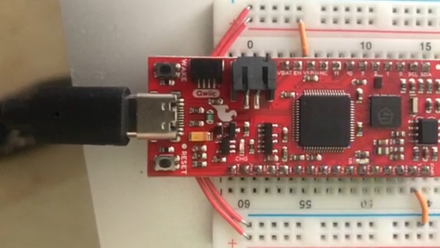
Morse Code Example
Play a message in Morse code by blinking LEDs.
Demonstrate EasyREDVIO
Similarities to Lab 7

Slide 44
Morse Code Example
// morse.c
// David_Harris@hmc.edu
// Arduino-like library for IO functions
#include "EasyREDVIO.h"
#define DUR 100

Slide 45
Morse Code Example
// Define Morse code for letters
char codes[26][5] = {
".-", // A
"-...", // B
"-.-.", // C
"-..", // D
".", // E
"..-.", // F
"--.", // G
"....", // H
"..", // I
".---", // J
"-.-", // K
".-..", // L
"--", // M
"-.", // N
"---", // O
".--.", // P
"--.-", // Q
".-.", // R
"...", // S
"-", // T
"..-", // U
"...-", // V
".--", // W
"-..-", // X
"-.--", // Y
"--.." // Z
};

Slide 46
Morse Code Example
void playChar(char c) {
int i=0;
while (codes[c-'A'][i]) {
digitalWrite(5, 1); // turn on LED
if (codes[c-'A'][i] == '.') delay(DUR); // dot
else delay(3*DUR); // dash
digitalWrite(5, 0); // turn off LED
delay(DUR); // pause between elements
i++;
}
delay(DUR*2); // extra pause between characters
}

Slide 47
Morse Code Example
void playStr(char msg[]) {
int i=0;
while(msg[i]) playChar(msg[i++]);
}

Slide 48
Morse Code Example
int main(void) {
pinMode(5, OUTPUT); // Blue LED
while (1) {
playStr("SOS");
// pause between words
delay(DUR*4);
}
}

Slide 49
Embedded Systems
Interfacing

Slide 50
Interfacing
Interfacing: connecting external devices to a microcontroller
Sensors
Actuators
Other Processors
Interfacing Methods
Parallel
Serial
SPI: Serial Peripheral Interface
1 clock, 1 data out, 1 data in pin
UART: Universal Asynchronous Receiver/Transmitter
no clock, 1 data out, 1 data in pin, agree in software about intended data rate
I2C: Inter-Integrated Circuit
1 clock, 1 bidirectional data pin
Analog
ADC: Analog/Digital Converter
DAC: Digital/Analog Converter
PWM: Pulse Width Modulation

Slide 51
Parallel Interfacing
Connect 1 wire / bit of information
Example: 8-bit parallel interface to send a byte at a time
Also send clock or REQ/ACK (request/acknowledge) to indicate when data is ready
Parallel busses are expensive and cumbersome because of the large number of wires
Mostly used for high-performance applications such as DRAM interfaces

Slide 52
Serial Interfacing
Serial interface sends one bit at a time
Use many clock cycles to send a large block of information
Also send timing information about when the bits are valid
Common Serial Interfaces:
Serial Peripheral Interface (SPI)
Serial clock, 2 unidirectional data wires (MOSI, MISO)
Very common, easy to use
Inter-Integrated Circuit (I2C) “I squared C”
1 clock, 1 bidirectional data wire
Fewer wires, more complex internal hardware
Universal Asynchronous Receiver/Transmitter (UART) “you-art”
2 unidirectional data wires (Tx, Rx)
Asynchronous (no clock); configure (agreed upon) speed at each end

Slide 53
Embedded Systems
SPI

Slide 54
Serial Peripheral Interface (SPI)
SPI is an easy way to connect devices
Master device communicates with one or more slave devices
Slave select signals indicate which slave is chosen
Master sends clock and data out. Slave sends back data in.
Signals:
SCK/SCLK: (Serial Clock) Generated by master; one pulse per bit
MOSI: (Master Out Slave In) serial data from master to slave
MISO: (Master In Slave Out) serial data from slave to master
SS/CE/CS: (Slave select/Chip Enable/Chip Select) optional, one or more, may be active low

Slide 55
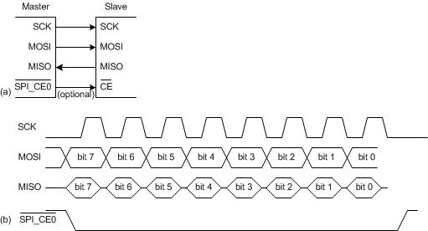
SPI Waveforms
SPI Slave hardware can be just a shift register
SCK: Generated by master; one pulse per bit
MOSI: (Master Out Slave In) serial data from master to slave
MISO: (Master In Slave Out) serial data from slave to master
CE: (Chip Enable) optional, one or more, may be active low

Slide 56
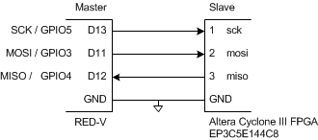
SPI Connection
Generic Master to Several Slaves
RED-V Master to One Slave
en.wikipedia.org/wiki/Serial_Peripheral_Interface_Bus#/media/File:SPI_three_slaves.svg

Slide 57
Slave Select
Slave Select is active low
Variously named NSS or SS or CE or CS
Turns ON device when 0, OFF when 1
Turning OFF the slave device may save power
Options:
1 slave device: tie slave select active
1 or more slave devices: use GPIO pins to turn desired device ON before SPI transaction, turn device back OFF afterward
1 or more slave devices: use SPI controller to automatically pulse the desired SS pin during a transaction

Slide 58
SPI Communication
Configure
Choose port
FE310 has SPI1 and SPI2. Let’s use SPI1.
Set SPI SCK, MISO, MOSI, CS0 pins to IOF0 mode
Set Baud Rate (1 MHz or less prudent on a breadboard)
Clock Polarity
CPOL = 0 (default): clock idles at 0
CPOL = 1: clock idles at 1
Clock Phase
CPHA = 0: sample MOSI on the first clock transition
CPHA = 1: sample MOSI on the second clock transition
Set other control registers as needed
See EasyREDVIO code

Slide 59
SPI Communication Continued
Transmit data
Wait for the txdata full flag to be 0 indicating SPI is ready for new data.
Write byte to txdata data field.
SPI will generate 8 clocks and send the 8 bits of data, while receiving 8 bits back.
Receive data
Read rxdata register.
If rxdata empty flag is 1, there is no data yet. Repeat read.
When empty flag is 0, there is valid data in the rxdata field.

Slide 60
SPI Registers
Base Address
SPI1 0x10024000
SPI2 0x10034000
Baud Rate
sckdiv bits 11:0 indicate div
F_{sck} = F_{in} / 2(div+1)
F_{in} is 16 MHz coreclk
Clock Mode
sckmode bit 0: pha (Clock Phase)
sckmode bit 1: pol (Clock Polarity
Transmit Data Register
txdata bits 7:0: data (write to transmit)
txdata bit 31: full (1 indicates FIFO can accept data)
Receive Data Register
rxdata bits 7:0: data (read received data)
rxdata bit 31: empty (1 indicates no data ready)

Slide 61
EasyREDVIO SPI Library
///////////////////////////////////////////////////////////////////////////////
// SPI Registers
///////////////////////////////////////////////////////////////////////////////
typedef struct
{
volatile uint32_t div : 12; // Clock divisor
volatile uint32_t : 20;
} sckdiv_bits;
typedef struct
{
volatile uint32_t pha : 1; // Serial clock phase
volatile uint32_t pol : 1; // Serial clock polarity
volatile uint32_t : 30;
} sckmode_bits;
…
typedef struct
{
volatile uint32_t data : 8; // Transmit data
volatile uint32_t : 23;
volatile uint32_t full : 1; // FIFO full flag
} txdata_bits;
typedef struct
{
volatile uint32_t data : 8; // Received data
volatile uint32_t : 23;
volatile uint32_t empty : 1; // FIFO empty flag
} rxdata_bits;
…
From FE310 Manual

Slide 62
EasyREDVIO SPI Library
typedef struct
{
volatile sckdiv_bits sckdiv; // (SPI offset 0x00) Serial clock divisor
volatile sckmode_bits sckmode; // (SPI offset 0x04) Serial clock mode
volatile uint32_t Reserved1[2];
volatile csid_bits csid; // (SPI offset 0x10) Chip select ID
volatile csdef_bits csdef; // (SPI offset 0x14) Chip select default
volatile csmode_bits csmode; // (SPI offset 0x18) Chip select mode
volatile uint32_t Reserved2[3];
volatile delay0_bits delay0; // (SPI offset 0x28) Delay control 0
volatile delay1_bits delay1; // (SPI offset 0x2C) Delay control 1
volatile uint32_t Reserved3[4];
volatile fmt_bits fmt; // (SPI offset 0x40) Frame format
volatile uint32_t Reserved4[1];
volatile txdata_bits txdata; // (SPI offset 0x48) Tx FIFO data
volatile rxdata_bits rxdata; // (SPI offset 0x4C) Rx FIFO data
volatile txmark_bits txmark; // (SPI offset 0x50) Tx FIFO watermark
volatile rxmark_bits rxmark; // (SPI offset 0x54) Rx FIFO watermark
volatile uint32_t Reserved5[2];
volatile fctrl_bits fctrl; // (SPI offset 0x60) SPI flash control*
volatile ffmt_bits ffmt; // (SPI offset 0x64) SPI flash instr format*
volatile uint32_t Reserved6[2];
volatile ie_bits ie; // (SPI offset 0x70) SPI interrupt enable
volatile ip_bits ip; // (SPI offset 0x74) SPI interrupt pending
// Registers marked * are only present on controllers with the direct-map flash ifc.
} SPI;
From FE310 Manual

Slide 63
EasyREDVIO SPI Library
///////////////////////////////////////////////////////////////////////////////
// SPI
///////////////////////////////////////////////////////////////////////////////
#define QSPI0_BASE (0x10014000U) // QSPI0 memory-mapped base address
#define SPI1_BASE (0x10024000U) // SPI1 memory-mapped base address
#define SPI2_BASE (0x10034000U) // SPI2 memory-mapped base address
// Set up pointer to SPI structures at the base addresses
#define QSPI0 ((SPI*) QSPI0_BASE)
#define SPI1 ((SPI*) SPI1_BASE)
#define SPI2 ((SPI*) SPI2_BASE)

Slide 64
EasyREDVIO SPI Library
void spiInit(uint32_t clkdivide, uint32_t cpol,
uint32_t cpha) {
pinMode(2, GPIO_IOF0); // CS0
pinMode(3, GPIO_IOF0); // MOSI
pinMode(4, GPIO_IOF0); // MISO
pinMode(5, GPIO_IOF0); // SCK
SPI1->sckdiv.div = clkdivide; // Set clock divide
SPI1->sckmode.pol = cpol; // Set polarity
SPI1->sckmode.pha = cpha; // Set phase
}

Slide 65
EasyREDVIO SPI Library
uint8_t spiSendReceive(uint8_t send) {
// Wait until transmit FIFO is ready for new data
while(SPI1->txdata.full);
// Transmit the character over SPI
SPI1->txdata.data = send;
rxdata_bits rxdata;
while (1) {
// Read the rxdata register EXACTLY once
rxdata = SPI1->rxdata;
// If the empty bit was not set, return the data
if (!rxdata.empty) {
return (uint8_t)rxdata.data;
}
}
}

Slide 66
Generalized pinMode
#define INPUT 0
#define OUTPUT 1
#define GPIO_IOF0 2
#define GPIO_IOF1 3
void pinMode(int gpio_pin, int function)
{
switch(function) {
case INPUT:
GPIO0->input_en |= (1 << gpio_pin); // Sets a pin as an input
GPIO0->iof_en &= ~(1 << gpio_pin); // Disable IOF
break;
case OUTPUT:
GPIO0->output_en |= (1 << gpio_pin); // Set pin as an output
GPIO0->iof_en &= ~(1 << gpio_pin); // Disable IOF
break;
case GPIO_IOF0:
GPIO0->iof_en |= (1 << gpio_pin); // Enable IOF
GPIO0->iof_sel &= ~(1 << gpio_pin); // IO Function 0
break;
case GPIO_IOF1:
GPIO0->iof_en |= (1 << gpio_pin); // Enable IOF
GPIO0->iof_sel |= (1 << gpio_pin); // IO Function 1
break;
}
}

Slide 67
SPI Communication
#include <stdint.h>
#include "EasyREDVIO.h"
int main(void) {
uint8_t sample;
spiInit(15, 0, 0); // Initialize the SPI to 500 KHz
while(1) {
spiSendReceive('0x60');
sample = spiSendReceive('0x00’);
printf("Read %d\n", sample);
delay(200);
}
}

Slide 68
Embedded Systems
Example:
SPI Accelerometer

Slide 69
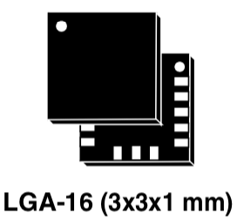
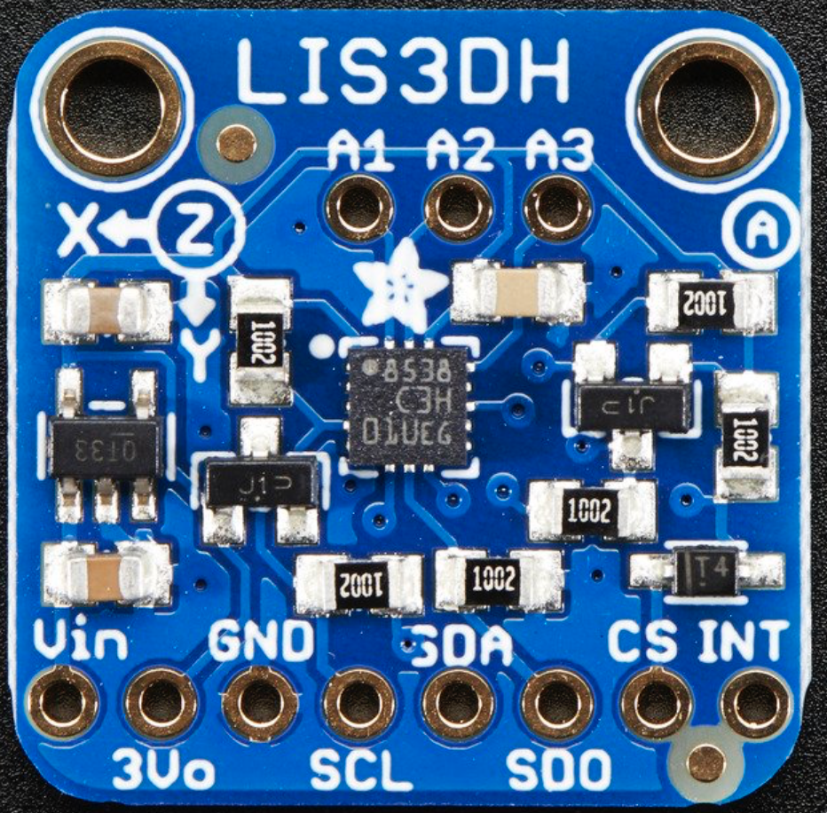
Example: SPI Interface to Accelerometer
LIS3DH 3-axis accelerometer
Measures X, Y, Z acceleration
2-8 G Full scale (configurable)
SPI interface with 16-bit transfers
~1 mg sensitivity
3x3 mm land grid array package
Hard to assemble without tooling
Available on a breakout board
$4.95 from Adafruit

Slide 70
LIS3DH Internal Operation
MEMS cantilevers move based on acceleration
Changes capacitance, sensed by ADC
Temperature compensation for good accuracy
st.com LIS3DH Data Sheet

Slide 71
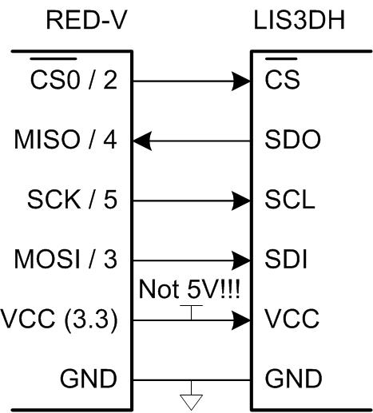
Microcontroller → Accel Interface
3.3V, GND
Connecting 5V may cook LIS3DH
SPI interface
LIS3DH also has I2C interface
Don’t connect these pins

Slide 72
SPI Data Packets
Communicate with SPI through internal registers
Each register has 6-bit address, 8 bits of data
Use a 16-bit SPI transaction
RWbar = 1 to read, 0 to write. MSbar = 0 for single register accesses
Keep CS low for entire 16 cycles
st.com LIS3DH Data Sheet

Slide 73
SPI Write
RWbar = 0. MSbar = 0
Send 6-bit address of register to write
Send 8 bit data value to write to register
Receive 8 bits of dummy data back (discard)
st.com LIS3DH Data Sheet

Slide 74
SPI Read
RWbar = 1. MSbar = 0
Send 6-bit address of register to read
Send 8 bit dummy data
Receive 8 bits of read data
st.com LIS3DH Data Sheet

Slide 75
LISD3H Registers
Read WHO_AM_I to check
SPI interface working
Write CTRL_REG to
configure accel
Read OUT_X/Y/Z registers
to measure acceleration
16-bit 2’s complement values
Stored in 8-bit high and low regs
st.com LIS3DH Data Sheet

Slide 76
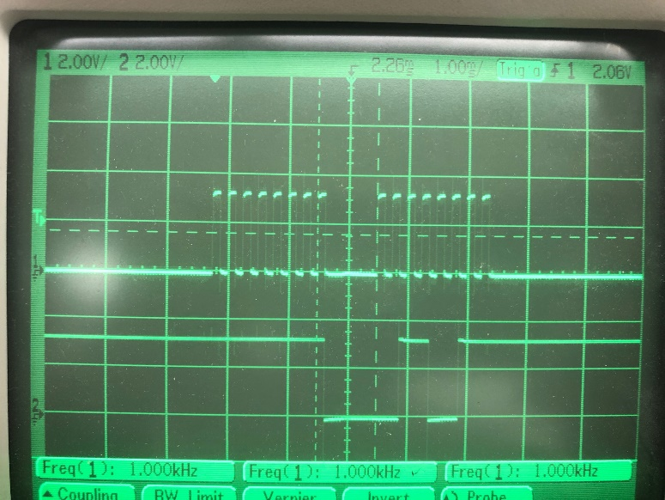
LISD3H WHO_AM_I
WHO_AM_I register (0x0F) always reads 0x33 = 51
Easy way to check your SPI wiring is correct
st.com LIS3DH Data Sheet
16 clock pulses
SCK
MISO
0x33

Slide 77
LISD3H Control Registers
CTRL_REG1 (0x20)
Write 0x77
Enable X, Y, Z axis measurements
Normal mode 400 Hz sampling
st.com LIS3DH Data Sheet

Slide 78
LISD3H Control Registers
CTRL_REG4 (0x23)
Write 0x88
Update output after each reading
High resolution (16-bit) mode
st.com LIS3DH Data Sheet

Slide 79
LISD3H Output Registers
Read X, Y, Z acceleration as 2 bytes each
Combine into 16-bit 2’s complement numbers
Accel = (Reading – Offset) * Scale
Must calibrate offset and scale
Measure reading at level, rotated +/- 90 degrees on each axis
Different offset and scale for each axis

Slide 80
Accelerometer Starter Code
// E85 Lab 8: Digital Level
// David Harris & Josh Brake
#include <stdint.h>
#include "EasyREDVIO.h"

Slide 81
Accelerometer Starter Code
void spiWrite(uint8_t address, uint8_t value) {
uint8_t hi, lo;
digitalWrite(2, 0); // pulse chip select
hi = spiSendReceive(address);
lo = spiSendReceive(value);
digitalWrite(2, 1); // release chip select
// discard returned values on a write transaction
}
uint8_t spiRead(uint8_t address) {
uint8_t hi, lo;
digitalWrite(2, 0); // pulse chip select
hi = spiSendReceive(address | 1 << 7); // set msb for reads
lo = spiSendReceive(0x00); // send dummy payload
digitalWrite(2, 1); // release chip select
return lo; // return low byte from a read transaction
}

Slide 82
Accelerometer Starter Code
int main(void) {
uint8_t debug;
int16_t x,y;
spiInit(15, 0, 0); // Initialize SPI pins and clocks
digitalWrite(2, 1);
pinMode(2, OUTPUT);
// Check WHO_AM_I register. should return 0x33 = 51
debug = spiRead(0x0F);
//Setup the LIS3DH for use
spiWrite(0x20, 0x77); // highest conversion rate, all axis on
spiWrite(0x23, 0x88); // block update, and high resolution
while(1) {
// Collect the X and Y values from the LIS3DH
x = spiRead(0x28) | (spiRead(0x29) << 8);
y = spiRead(0x2A) | (spiRead(0x2B) << 8);
// Small delay to reduce flicker
delay(100);
}
}

Slide 83
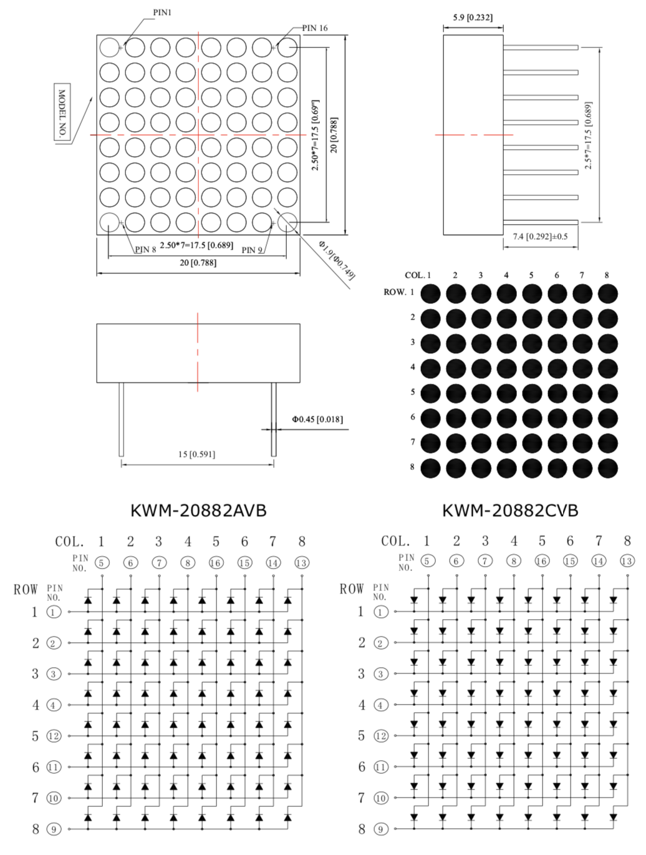
Lab 8: Digital Level
Goal of Lab 8 is to build a digital level
Accelerometer code on previous pages is provided
You move a dot around on
an LED matrix to indicate tilt
Use digitalWrite from
EasyREDVIO.h
cdn-shop.adafruit.com/datasheets/454datasheet.pdf

Slide 84
About these Notes
Digital Design and Computer Architecture Lecture Notes
© 2021 Sarah Harris and David Harris
These notes may be used and modified for educational and/or non-commercial purposes so long as the source is attributed.

